Slide 1

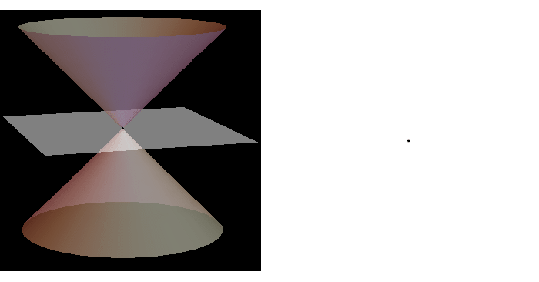
Unit 4
Conic Sections
A conic section is a curve obtained by intersecting a plane with a right circular cone.

Slide 2
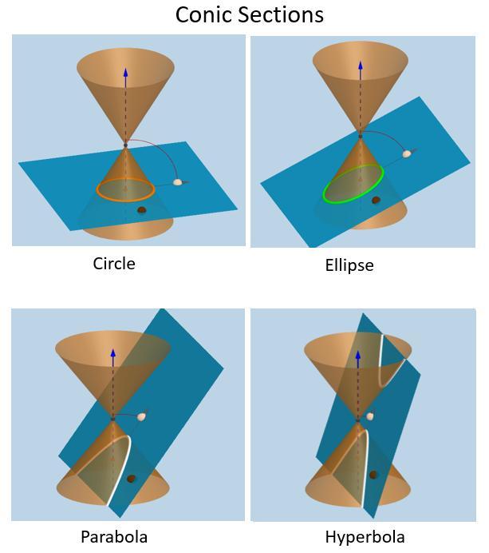

Slide 3
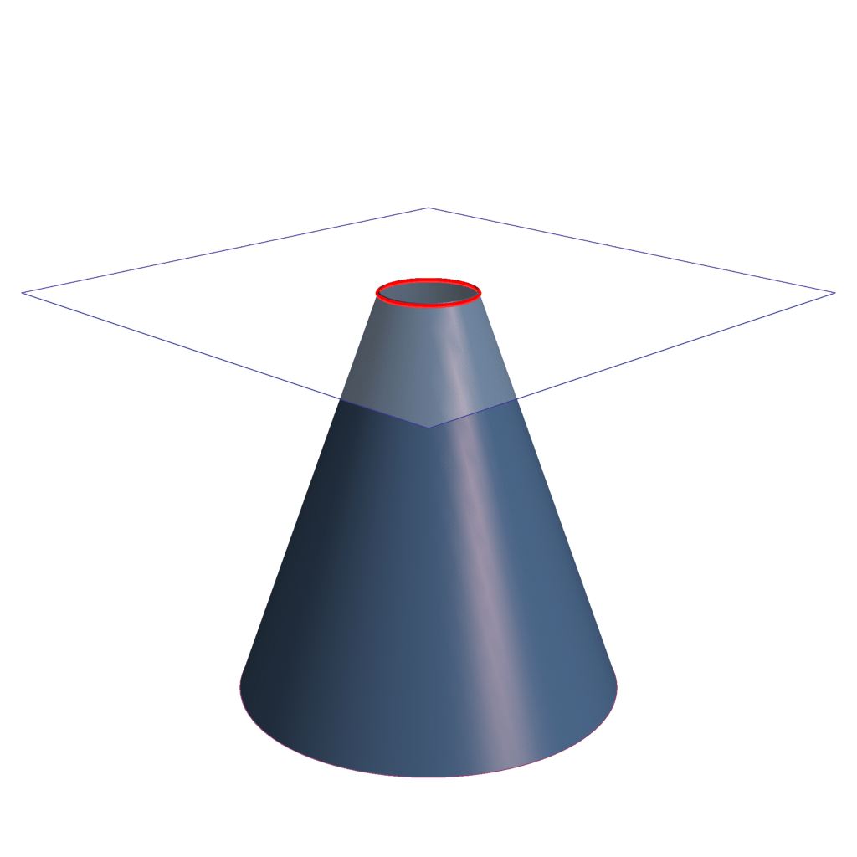
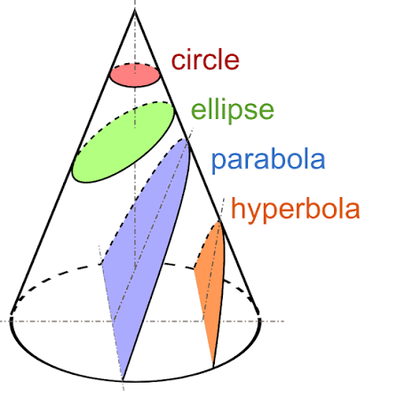
Depending on the angle and position of the intersecting plane, the resulting curve can be:

Slide 4
Why do we study Conics Sections ?
They Connect Mathematics with the Real World
Many natural and engineered phenomena have approximately conical-section shapes.
For example:
Planetary orbits → ellipses
Satellite trajectories → ellipses/parabolas/hyperbolas
Satellite dishes → parabolas
Car headlights → parabolic reflectors
Cooling towers → hyperbolic shapes
Circular wheels and gears → circles
Navigation and location systems → circles, ellipses and hyperbolas

Slide 5
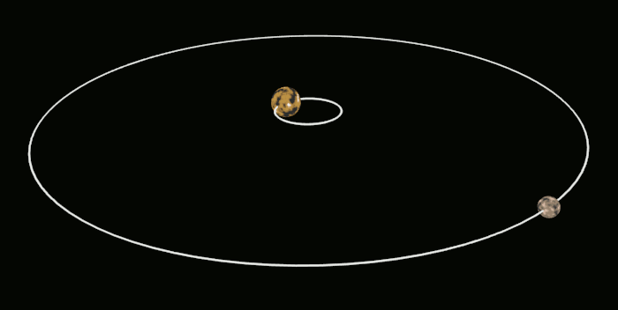
Planetary orbits → ellipses

Slide 6
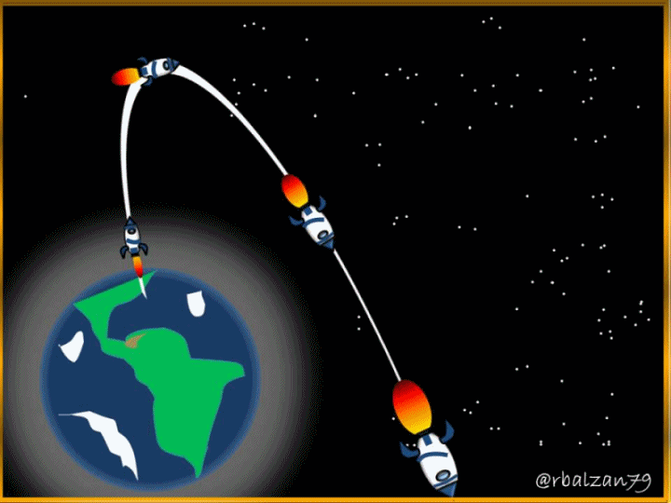
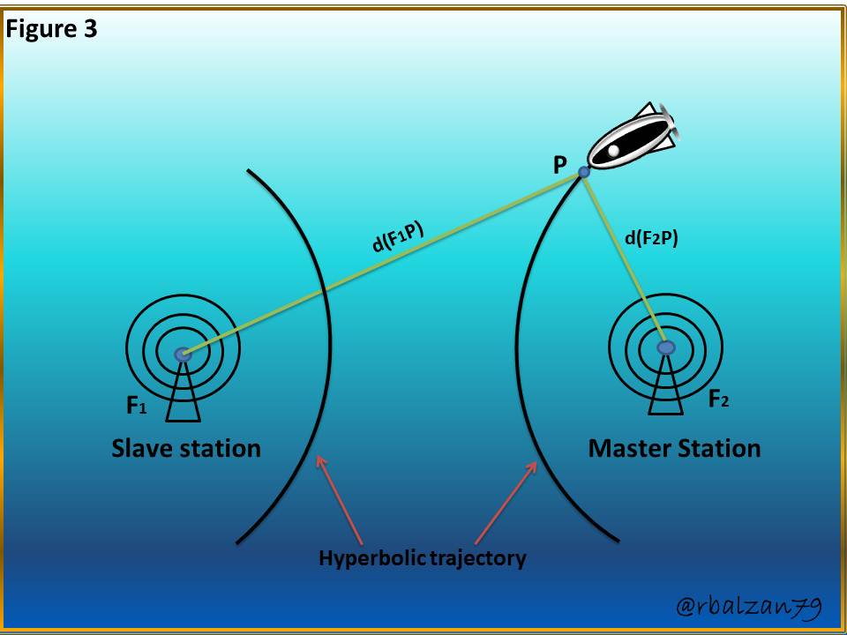
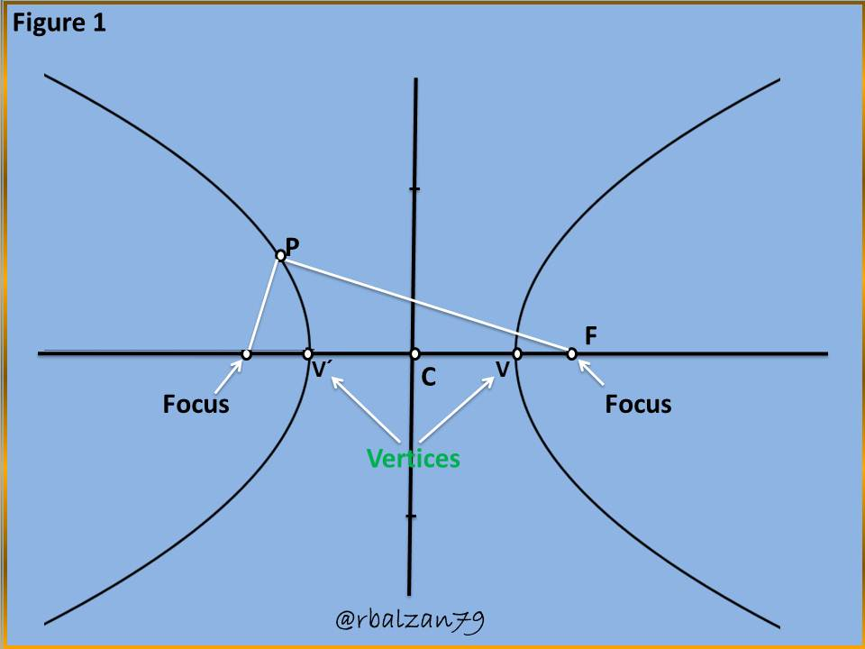
Satellite trajectories → ellipses/parabolas/hyperbolas

Slide 7
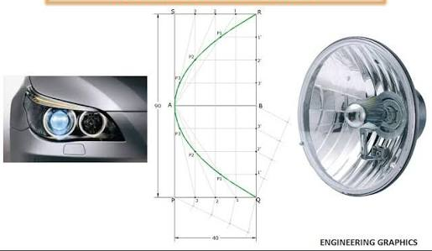
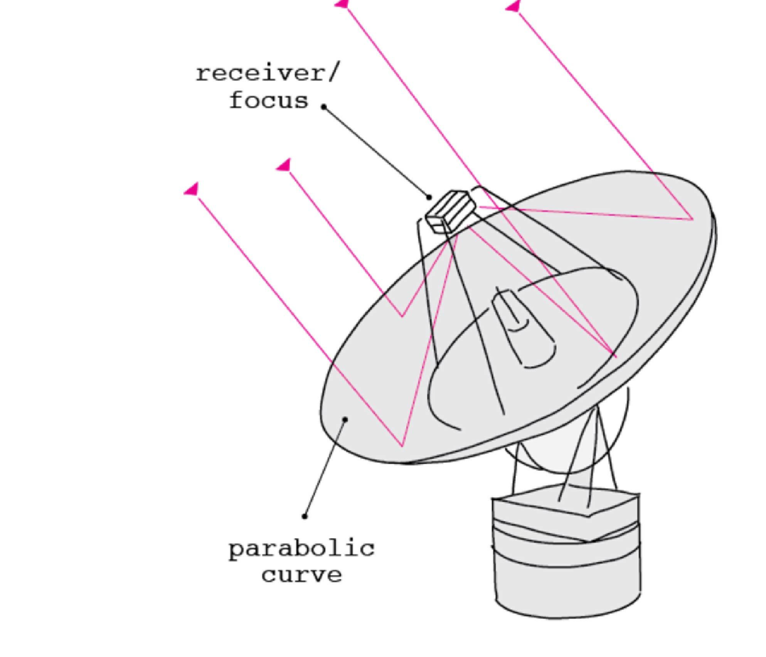
Car headlights → parabolic reflectors
Satellite dishes → parabolas

Slide 8
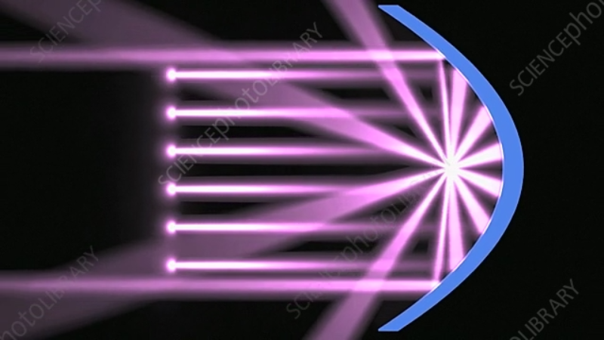
https://www.sciencephoto.com/media/1311146/view/parabolic-mirror-reflecting-light-animation

Slide 9
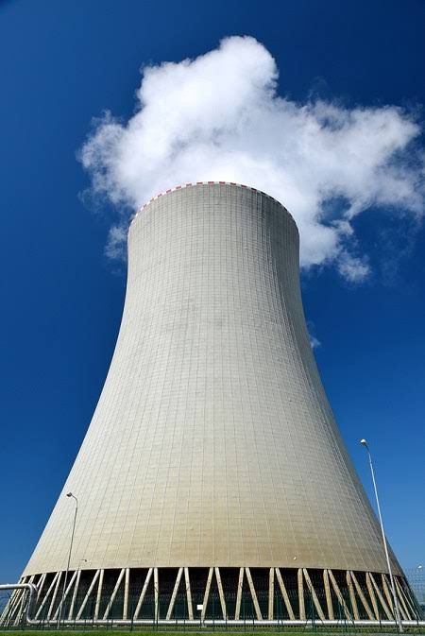
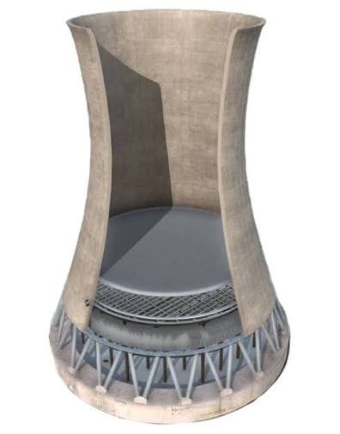
Cooling towers → hyperbolic shapes

Slide 10
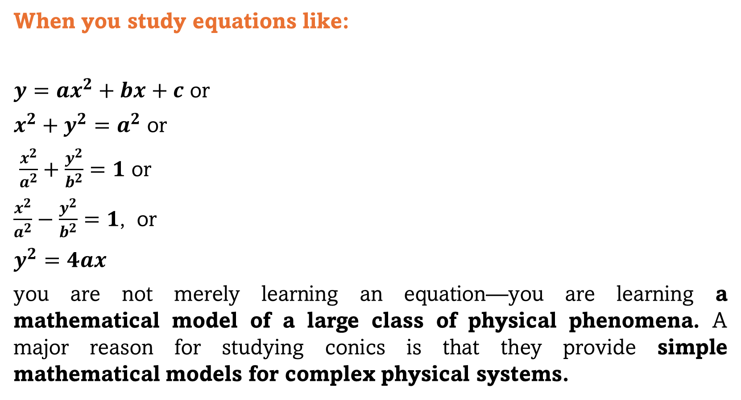
When you study equations like:
$y=ax^{2}+bx+c$ or
$x^{2}+y^{2}=a^{2}$ or
$\frac{x^{2}}{a^{2}}+\frac{y^{2}}{b^{2}}=1$ or
$\frac{x^{2}}{a^{2}}−\frac{y^{2}}{b^{2}}=1$, or
$$y^{2}=4ax$$
you are not merely learning an equation—you are learning a mathematical model of a large class of physical phenomena. A major reason for studying conics is that they provide simple mathematical models for complex physical systems.
These curves are among the most important objects in coordinate geometry because they connect algebra, geometry, calculus, physics, astronomy, engineering, computer graphics, and optimization.

Slide 11
Geometric Definition of a Conic
A conic can be defined as the locus of a point whose relationship with a fixed point and a fixed line satisfies a particular condition.
Vertex
The vertex is the point where the parabola changes direction. The vertex is also the point on the parabola closest to the directrix and closest to the focus.
Focus
The focus is a fixed point associated with the parabola. The focus tells us where the parabola is “pointing” toward geometrically and plays an important role in reflection properties.
Directrix
The directrix is a fixed line associated with the parabola.

Slide 12
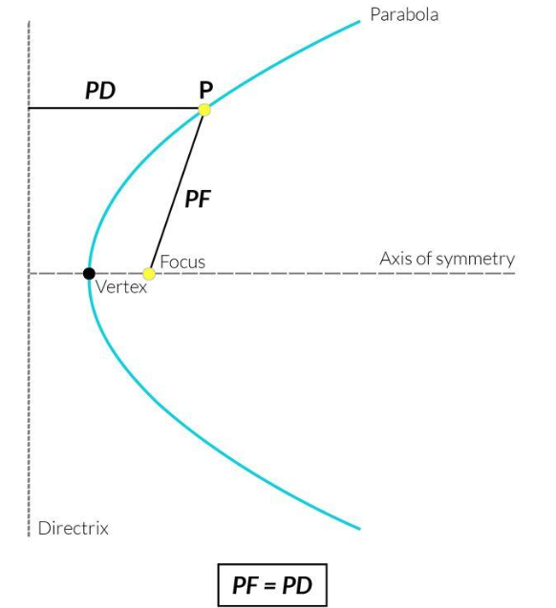
Parabola
A parabola is the locus of a point that moves in such a way that its distance from a fixed point is always equal to its perpendicular distance from a fixed straight line.
The fixed point is called the focus.
The fixed straight line is called the directrix.
The moving point is usually denoted by P (x, y).
Thus, the defining condition is PF = PD
where:
F is the Focus
D is the foot of the perpendicular from P to the directrix.

Slide 13
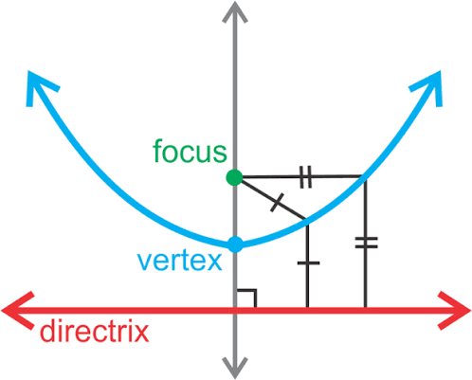
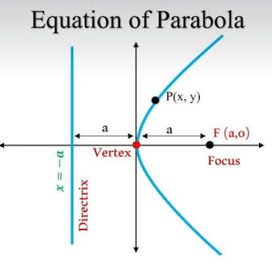
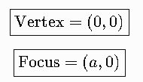






$$y^{2}=4ax$$
For this parabola

Slide 14

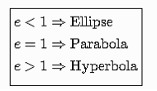
Eccentricity
The eccentricity, usually denoted by e , measures how much a conic differs from a circle in terms of its shape. The most general definition is based on the focus and directrix:
Note that a circle has no eccentricity e = 0

Slide 15
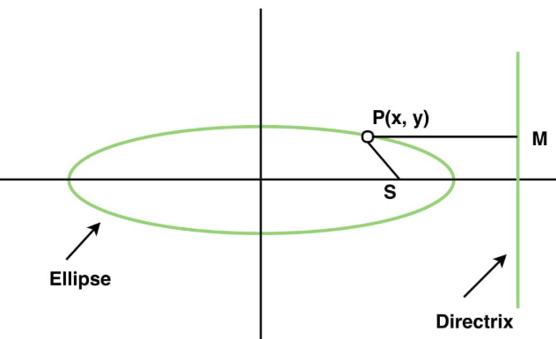
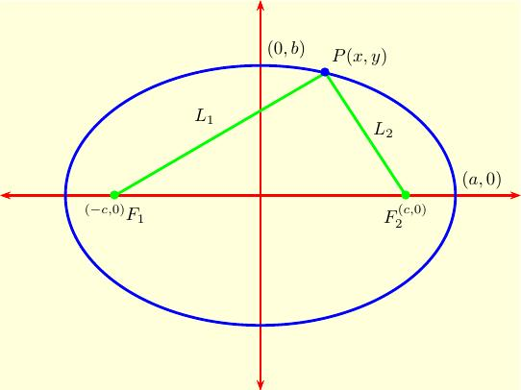
Ellipse
An ellipse is the locus of a point such that its distance from a fixed point (focus) divided by its perpendicular distance from a fixed line (directrix) is a constant e.
OR
An ellipse is the locus of a point that moves in a plane such that the sum of its distances from two fixed points is always constant.

Slide 16
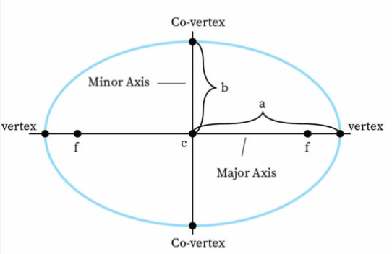
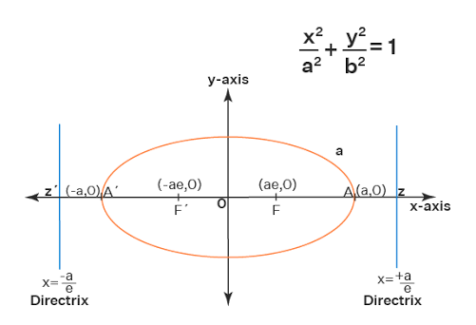
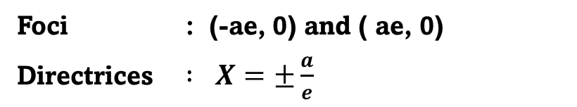

Ellipse
Foci : (-ae, 0) and ( ae, 0)
Directrices $: X=±\frac{a}{e}$
$$e=\sqrt{1−\frac{b^{2}}{a^{2}}}$$

Slide 17
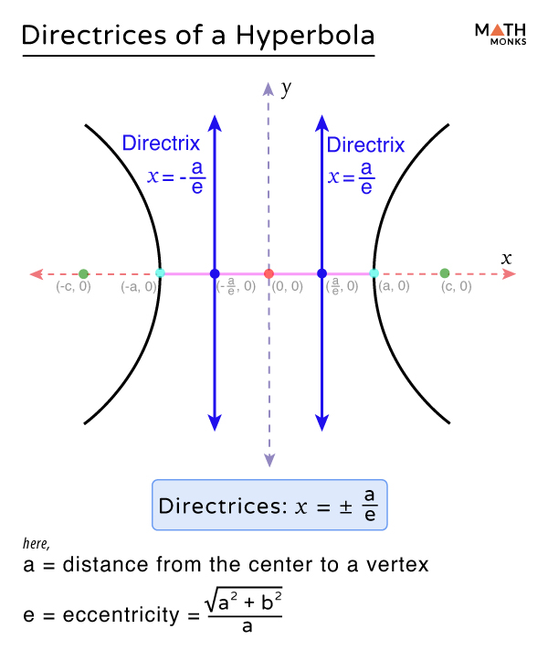

Hyperbola
A hyperbola is the locus of a point such that its distance from a fixed point (focus) divided by its perpendicular distance from a fixed line (directrix) is a constant
Asymptotes : $y=±\frac{b}{a}$

